Slide 1
Data Sets
Programming pig data – NYSE stock market
(ref. Gates, Alan. Programming Pig. " O'Reilly Media, Inc.", 2011.)

Slide 2
PIG
Pig can be run against the HDFS file system or on a local file system
It will first be presented in against a local file system as it requires less configuration and will allow you to start running examples immediately
We will start with the installation of pig to verify that you have everything up and running

Slide 3
PIG installation
Prerequisites for pig should already by loaded and ready to go on your machine from the startup script – this is :
Hadoop installation
java

Slide 4
Pig installation
Download pig
Gzip pig
tar –tf
Again, following the startup script that is presented.

Slide 5
Pig install
Next simply add pig to your path
You can test the installation with pig –help
Now to run examples you can start with the two files that are going to be provided which are the NYSE_daily and NYSE_dividends
If you have loaded those files on your machine you can start up pig and run them directly against your file structure (provided that you do not have an hdfs installation running already

Slide 6
Pig install
Taking the two files , go ahead and start pig in interpretive mode by typing
Pig –x local
If you are lazy and did not set a path you can run it directly by typing
./pig-0.11.1/bin/pig –x local
This will bring up “grunt” the interpretive prompt for running pig queries.

Slide 7
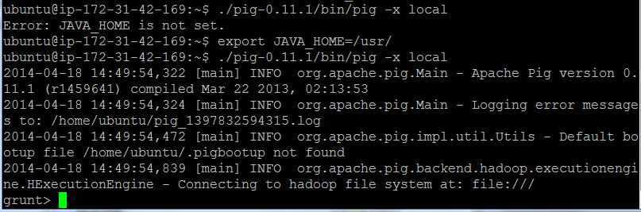

Slide 8
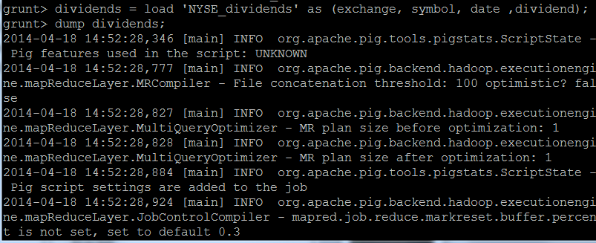
Read and write data from the NYSE_dividends
Starting in interpretive mode we perform a LOAD command , reading in a data source
This is followed by a DUMP

Slide 9
Breakdown
Two parts to our “load” statement, the left part of the “=“ is called the relation or alias.
In this case “dividend” looks like a variable – but is not as when this statement is executed, no MapReduce task is executed.
Since our dataset has records separated with a comma, we use the keyword: USING PigStorage(‘,’)
To test to see if the variable has the data that we loaded we execute the dump command

Slide 10
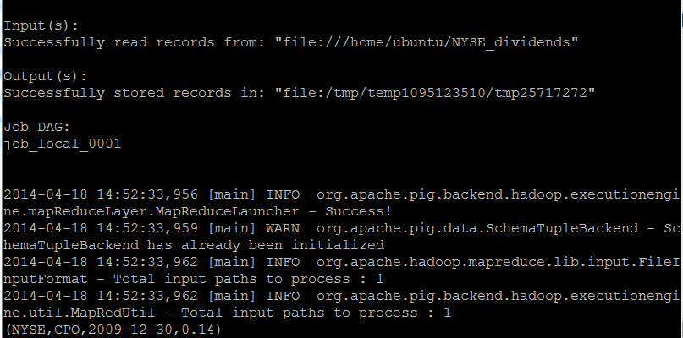

Slide 11
Here is an initial script
dividends = load ‘NYSE_dividends’ as (exchange, symbol, date, dividend);
groups = group dividends by symbol;
avg = foreach groups generate group , AVG(dividends.dividend);
store avg into ‘average_dividend’;
-- this stores the data into a file called average_dividend

Slide 12
Calculate the max dividend from each stock
dividends = load “NYSE_dividends” as (exchange, symbol, date, dividend);
groups = group dividends by symbol;
avg = foreach groups generate group , MAX(dividends.dividend);
store avg into ‘max_dividend’;
-- NOTE: the generate produces two attributes from the original four.

Slide 13
dividends = load “NYSE_dividends” as (exchange, symbol, date, dividend);
groups = group dividends by symbol;
avg = foreach groups generate group , MAX(dividends.dividend);
store avg into ‘max_dividend’;
-- NOTE: the generate produces two attributes from the original four.

Slide 14
dividends = load “NYSE_dividends” as (exchange, symbol, date, dividend);
groups = group dividends by symbol;
record = foreach groups generate group , MAX(dividends.dividend) * 100;
store record into ‘percent_dividend’;
-- NOTE: the generate produces two attributes from the original four.

Slide 15
dividends = load “NYSE_dividends” as (exchange, symbol, date, dividend);
groups = group dividends by symbol;
record = foreach groups generate group , MAX(dividends.dividend) * 100;
Dump record;

Slide 16
dividends = load “NYSE_dividends” as (exchange, symbol, date, dividend);
Records = foreach dividends generate symbol, dividend * 100.0;
Dump records;

Slide 17
Two good commands to learn right from the beginning are
Dump
limit

Slide 18
No schema join
divs = load 'NYSE_dividends' as (exchange, stock_symbol, date, dividends); daily = load 'NYSE_daily'; jnd = join divs by stock_symbol, daily by $1; dump jnd;

Slide 19
daily = load 'NYSE_daily'; fltrd = filter daily by $6 > $3; dump fltrd;
divs = load 'NYSE_dividends'; first10 = limit divs 10; dump first10;

